Slide 1
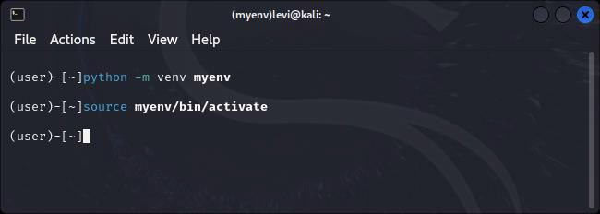
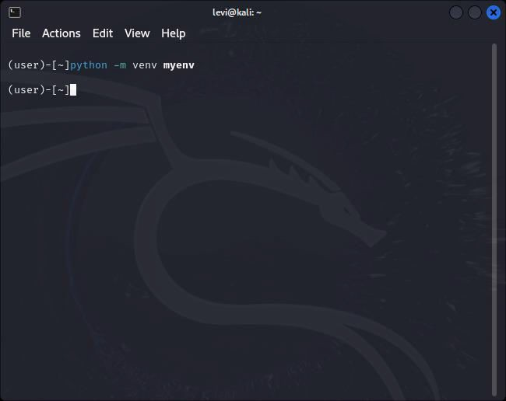
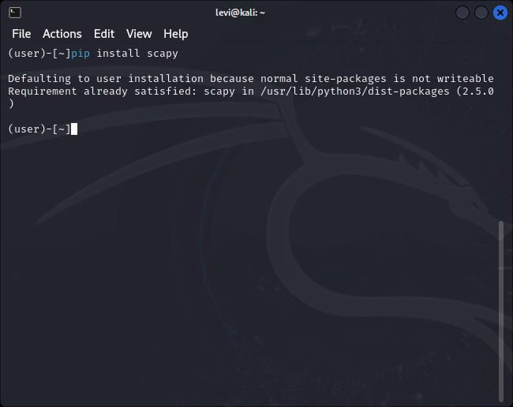
INEN Project 3 Detailed Documentation
Objective
The objective of this project is to set up a virtual environment using VMWare with Kali and utilize Scapy for network packet manipulation. This detailed documentation provides step-by-step instructions, code snippets, and results for each stage of the project.
Step 1: Setting up the Virtual Environment
I started by opening VMWare and launching the virtual environment with Kali Linux. The command prompt within the virtual environment was then accessed to proceed with the tasks.
Creating a python virtual environment
I opted to set up a Python virtual environment to ensure a clean and isolated workspace.
I need to control dependencies and maintain a reproducible development environment. By isolating the project's dependencies, I avoided conflicts with other projects and system-wide configurations. The Python virtual environment served as a practical solution for organized and efficient project development.
Activating the python virtual environment in the terminal
Step 2: Initiating Scapy
Scapy was initiated successfully by entering the command scapy in the command prompt. The Scapy console was ready for use.
Installing scapy (already installed)

Slide 2
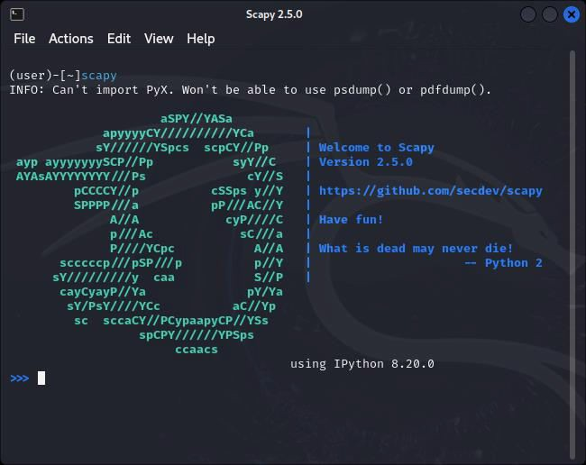
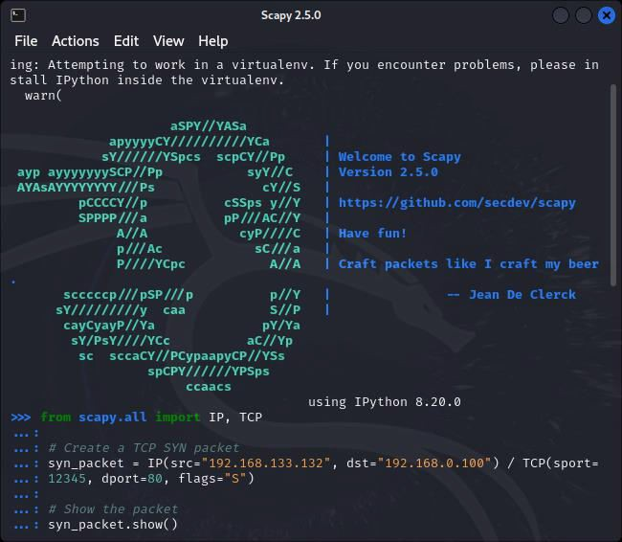
Step 3: Generating a TCP SYN Packet
In the Scapy console, I created a TCP SYN packet with the following commands:
Running scapy
Result: Scapy launched without any issues.

Slide 3
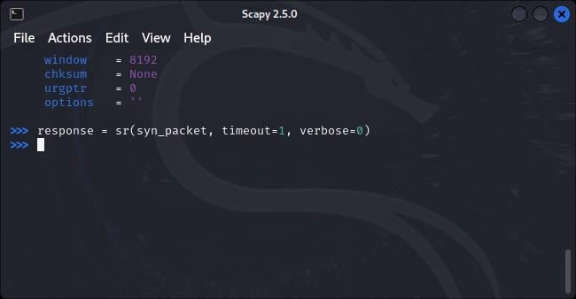
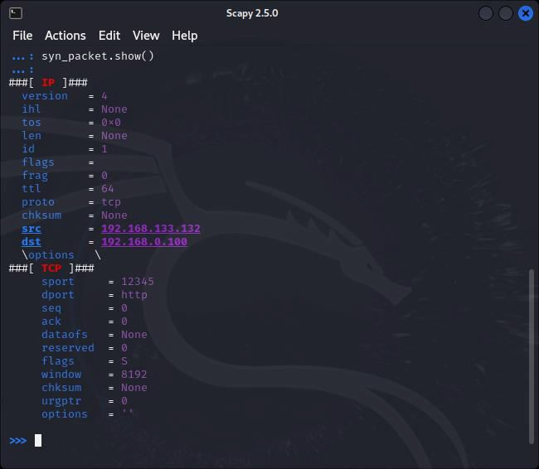
Results of generated packet
Result: The TCP SYN packet was successfully created and displayed. However, no response was received, and I noted this as part of the result.
Possible Reasons for No Response:
The target system may intentionally be configured to ignore or filter certain packets.
Firewalls or security measures on the target system might be blocking the specific type of packet.
Network issues, such as routing problems or misconfigurations, could prevent packets from reaching the target.

Slide 4
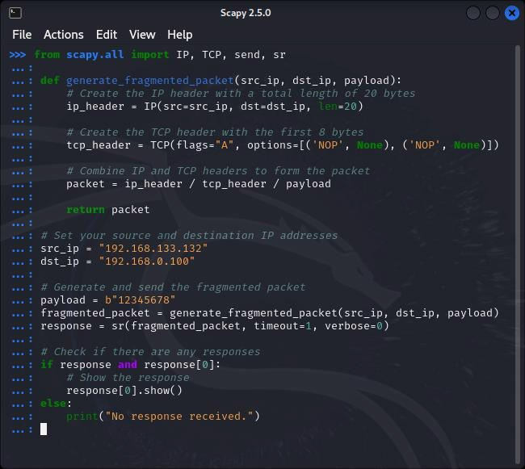
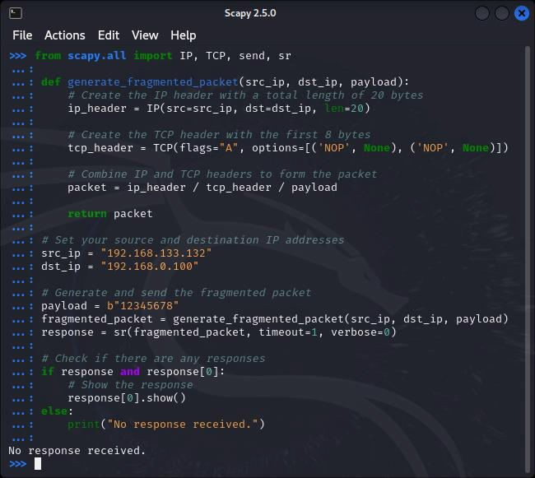
Step 4: Writing a Python Script
Next, I developed a Python script using Scapy to generate a fragment with 20 bytes of IP header and the first 8 bytes of the TCP header.
Step 5: Sending and Receiving the Fragmented Packet
In the Scapy console, I generated and sent the fragmented packet using the Python script:
Result: The Python script for generating a fragmented packet was successfully created.
Result: The fragmented packet was sent, but no response was received. I documented this in the result, along with possible reasons for the lack of response.

Slide 5
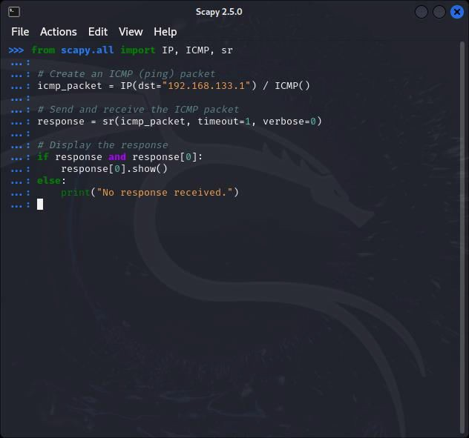
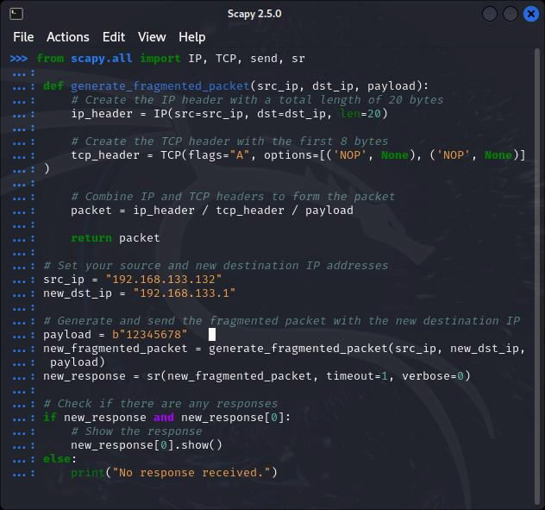
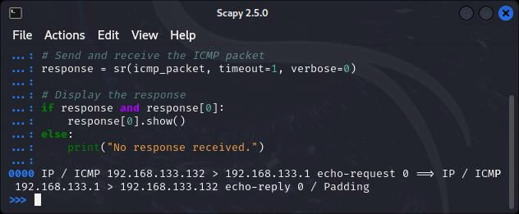
Tested using another destination ip address in my local network,still no response was received:
Using ICMP protocol which is ping
Result
Possible Reasons for No Response:
The target system may be configured to handle fragmented packets differently.
Firewalls or security measures on the target system may be blocking fragmented packets.
Network issues, such as packet loss or fragmentation issues, could be affecting the communication.
The response indicates that an ICMP echo-request packet was sent from 192.168.133.132 to 192.168.133.1, and the destination replied with an ICMP echo-reply. The show() method displays the details of the received packet.

Slide 6
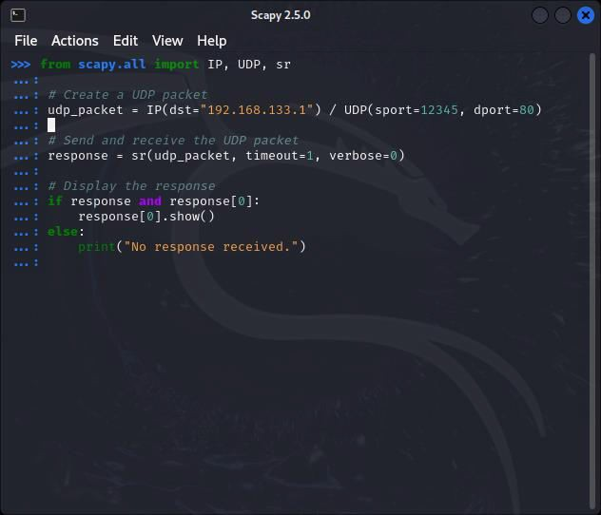
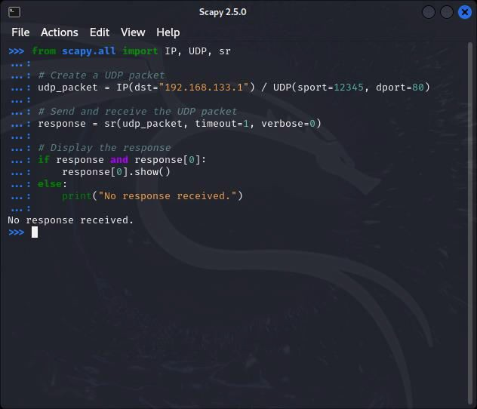
UDP protocol:
Result:
No response was received
Project Completion
I documented each step with screenshots and detailed explanations, ensuring correct syntax and accurate function names such as sr() and send. This comprehensive report is compiled in a Word document for INEN Project 3.

